Slide 1
Project Update
11/10/24

Slide 2
Overview of Projects
Project 1: First Paper
Submitted
Project 2: Asymptotics Paper
Edited to improve clarity
Currently with Eamonn
Project 3: GSK Avidity Barrier
Awaiting experimental replicates
Manuscript draft in preparation
Project 4: GSK Bispecific Selectivity
Project 5: Synapse Model
Awaiting data from Rachel
Paper plan in place
Linking number of trimers to response
Mazor steric penalty factor verification
Side project: Neuroblastoma with Simon
Just need to write small bit about generated figures

Slide 3
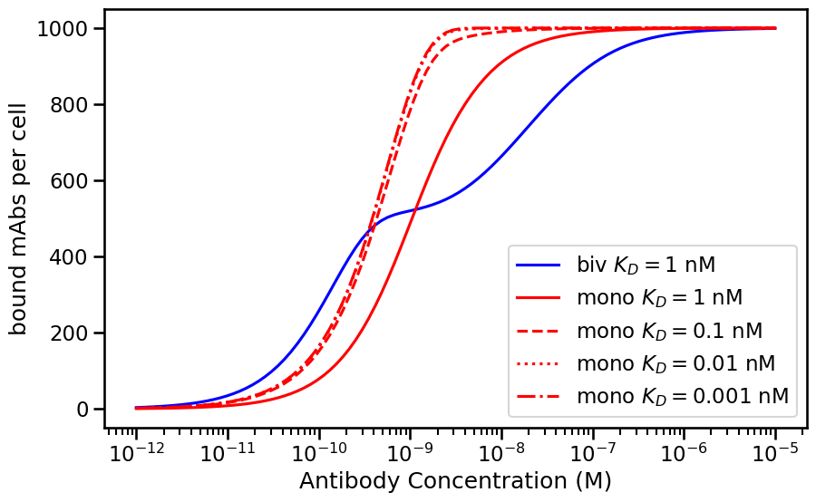
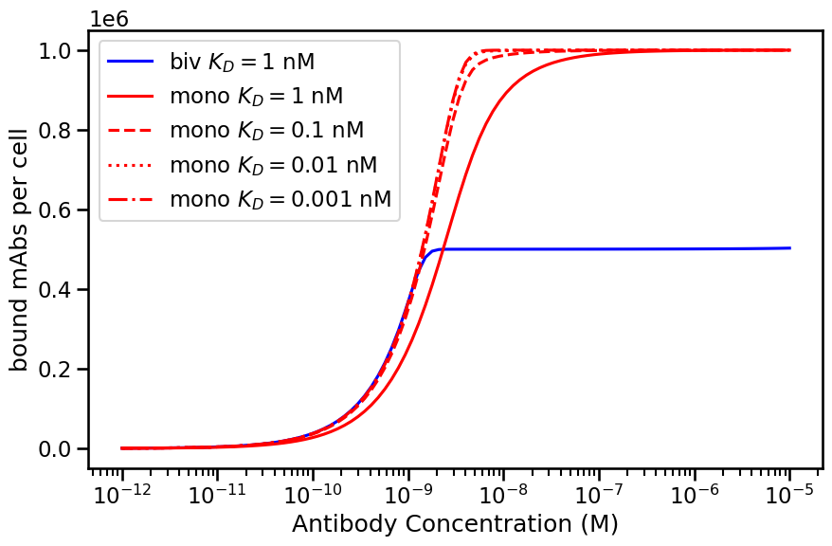
Prediction of Avidity Barrier
Bivalent same efficacy and slightly better EC50/potency as high affinity monovalent
Bivalent same potency but worse efficacy as high affinity monovalent
Rtot=10^3
D=10^-15
D=10^-13
Rtot=10^6

Slide 4
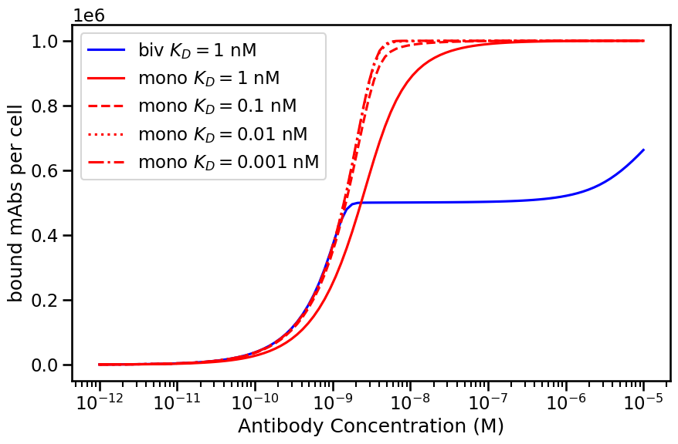

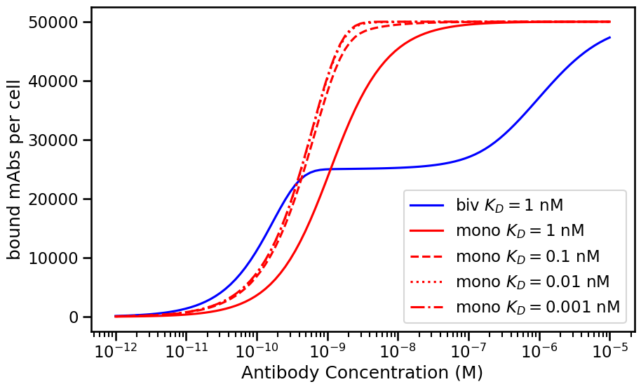
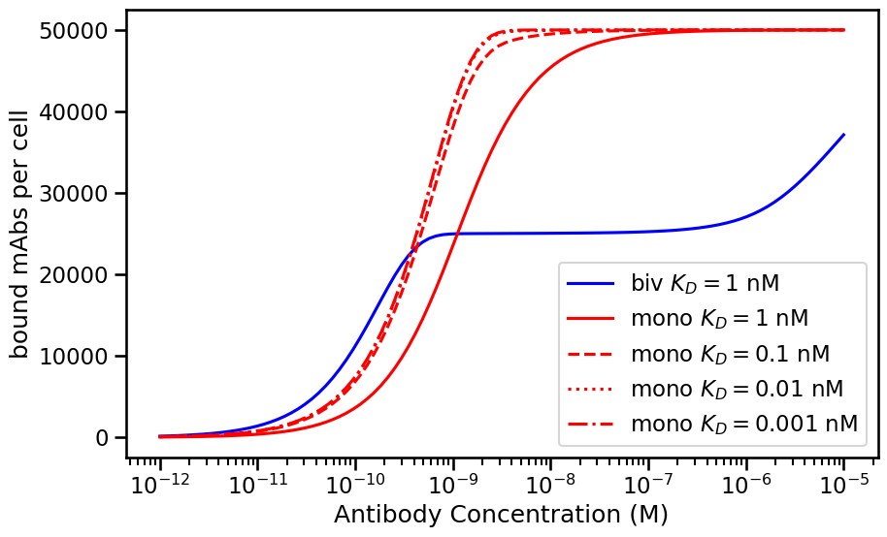
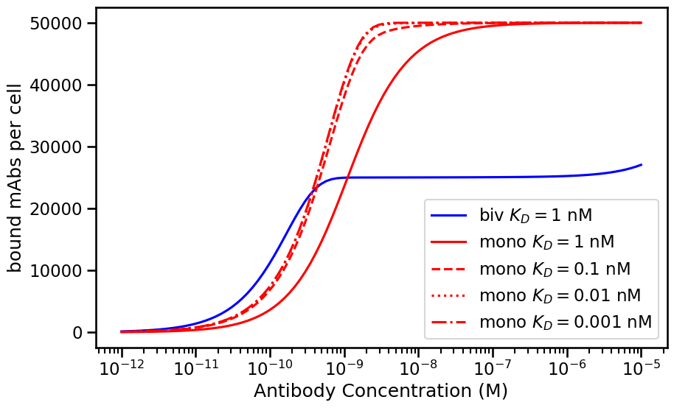
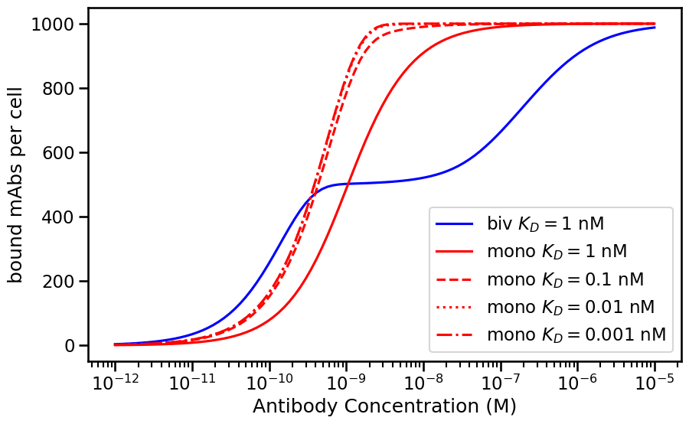
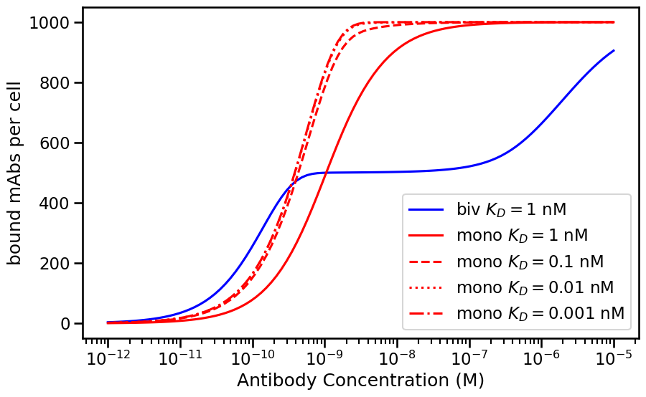
Rtot=10^6
Rtot=5 x10^4
Rtot=10^3
D=10^-15
D=10^-14
D=10^-13

Slide 5
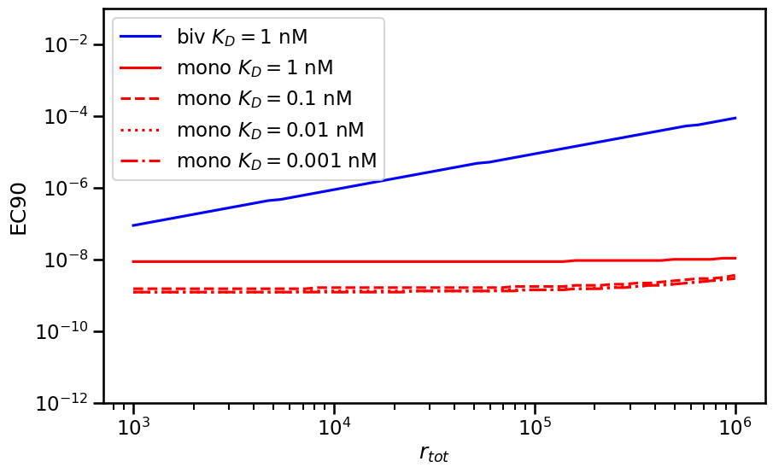
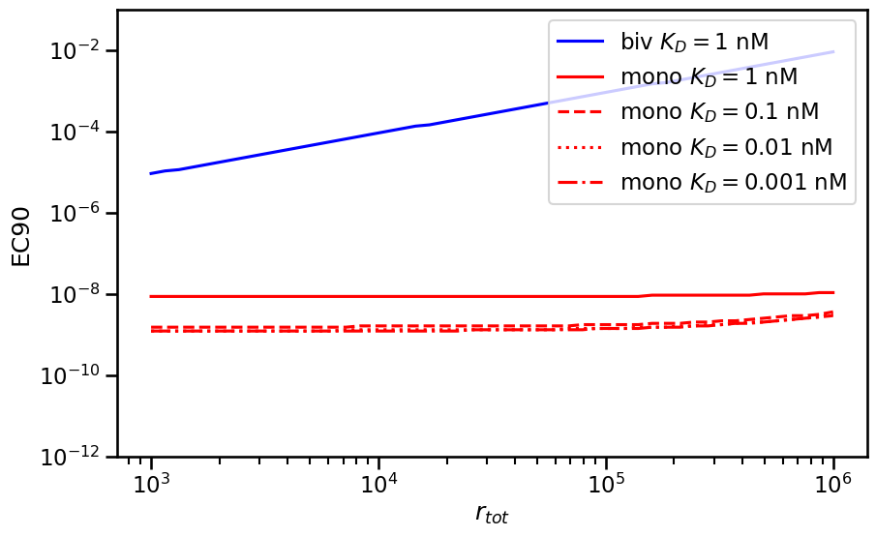
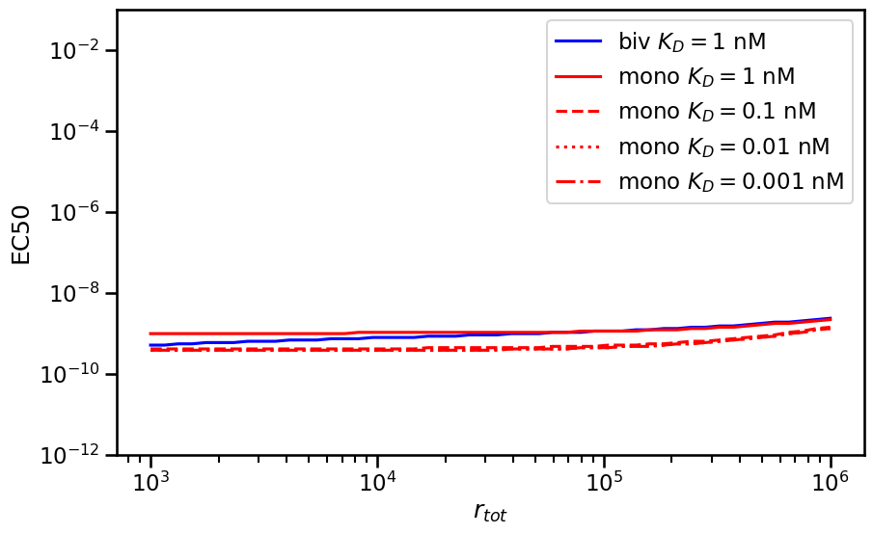
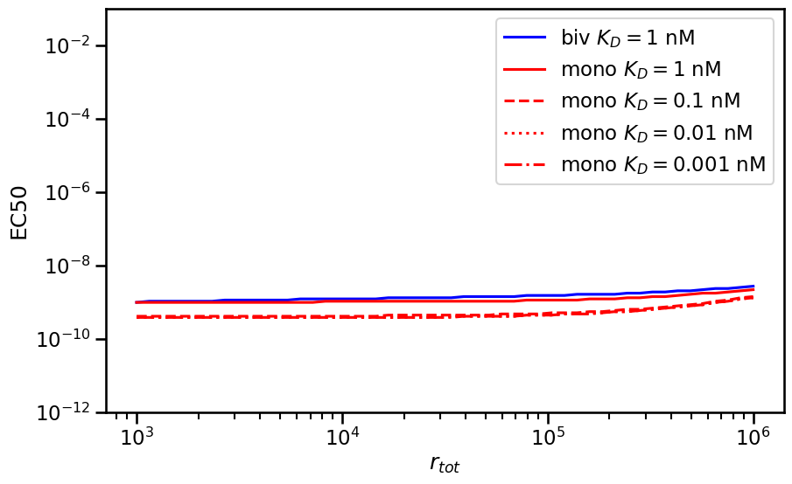
EC50 vs EC90
D=10^-15
D=10^-13

Slide 6
Calculating the Avidity Barrier
Avidity barrier = concentration at which bivalent
Reaches maximum – concentration at which
monovalent reaches maximum
Expectations:
Barrier large for high expression and vice versa
Barrier increases with strength of avidity (k2)
What is relationship with affinity?
Avidity Barrier

Slide 7
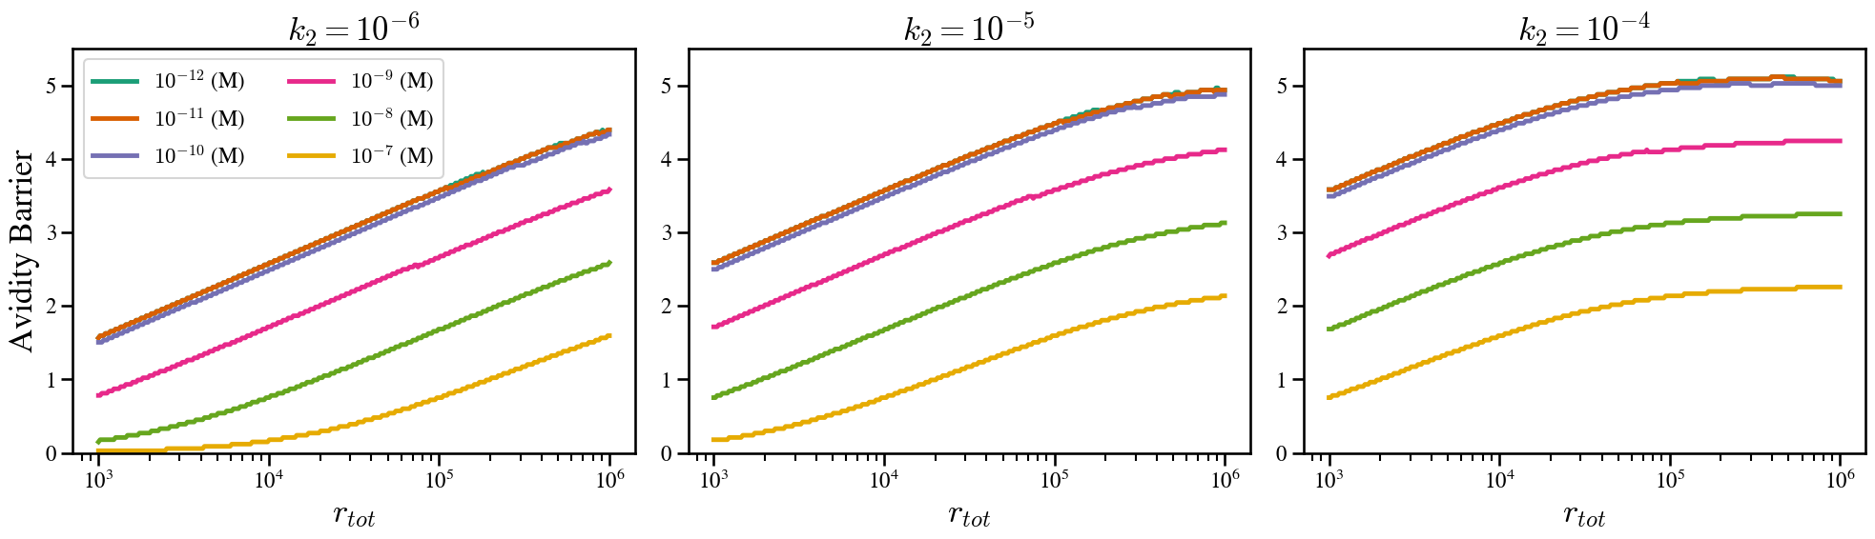
Size of barrier increases with affinity

Slide 8
Experimental validation
19 cell lines with expression data
4 antibodies with different affinities in both bivalent and monovalent formats
Test antibody binding in vitro

Slide 9
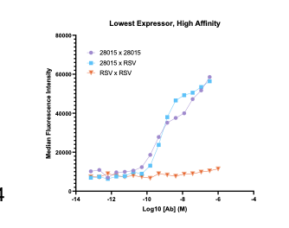
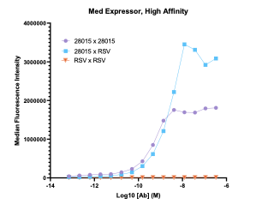
Low expressor = small avidity barrier
High expressor= large avidity barrier

Slide 10
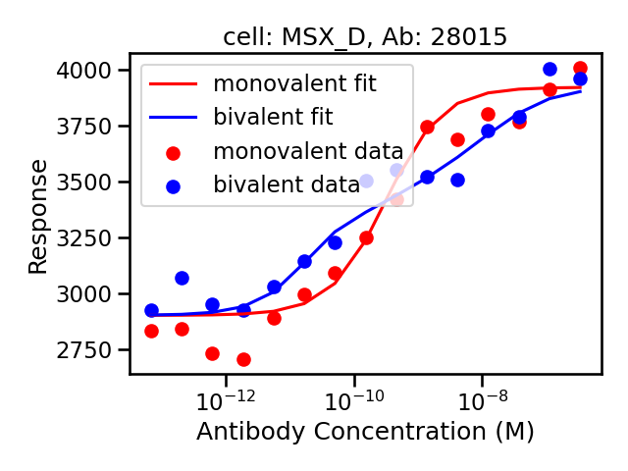
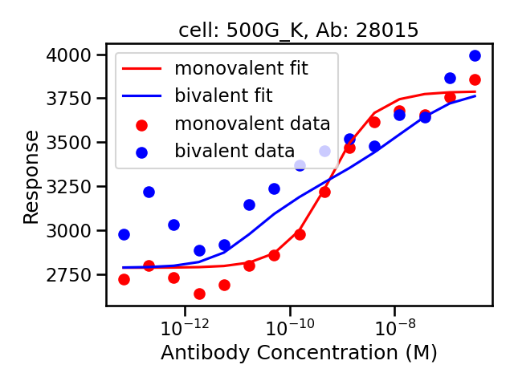
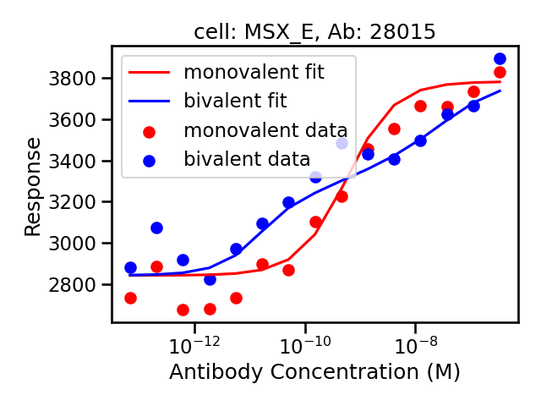

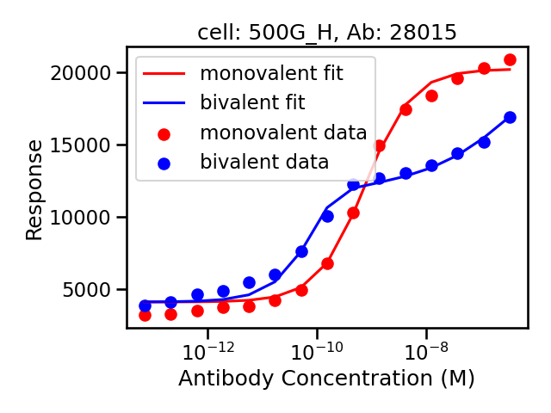
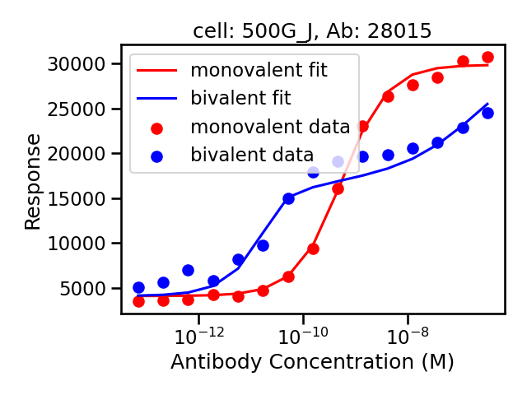
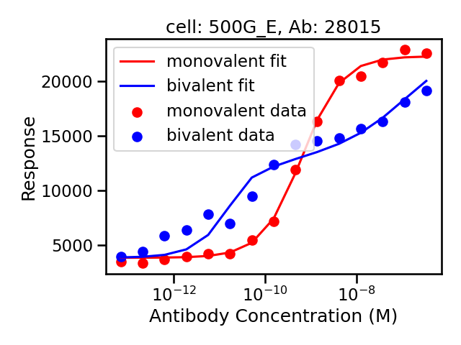
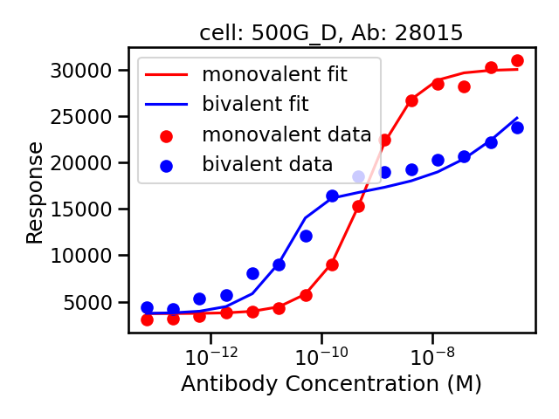
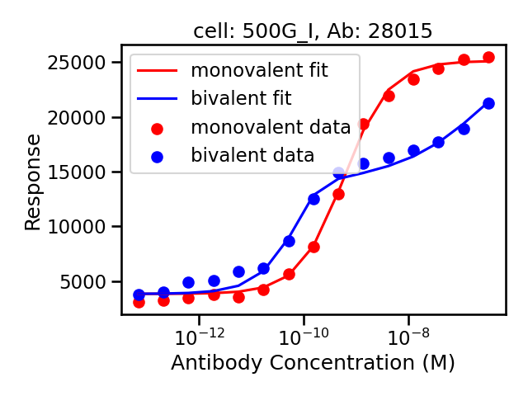
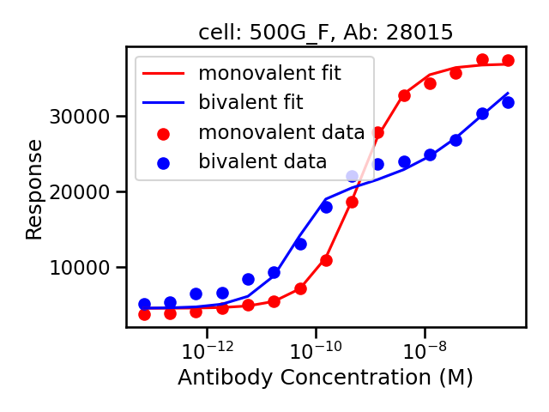
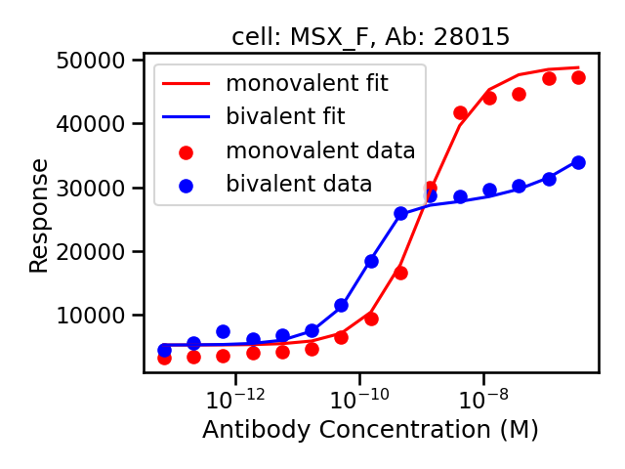
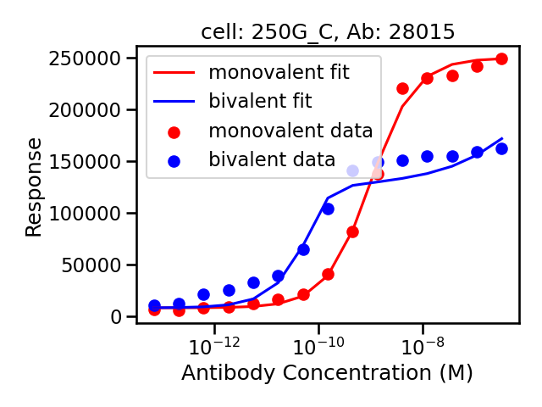
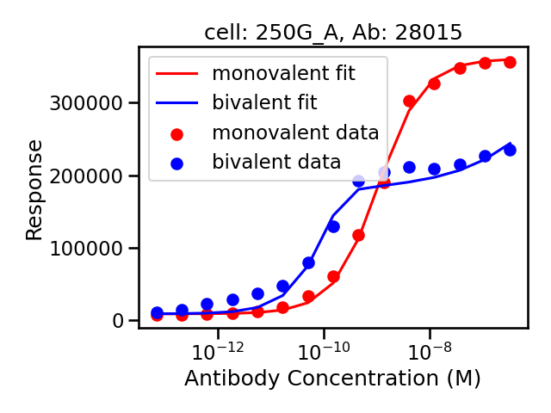
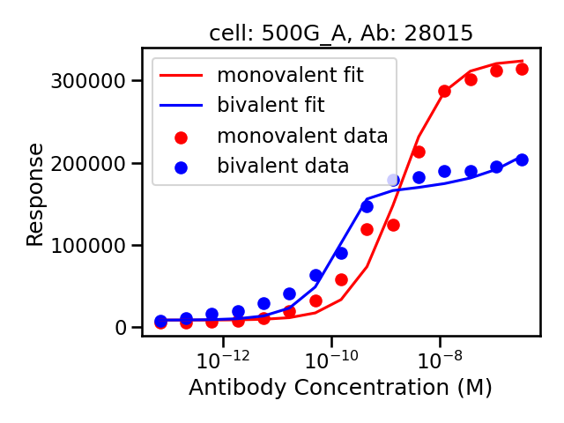
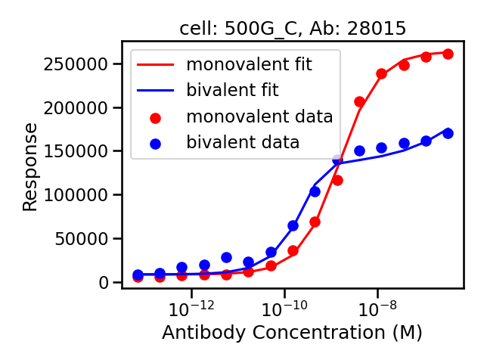
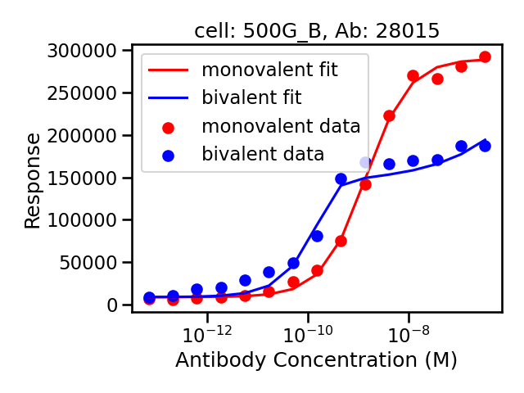
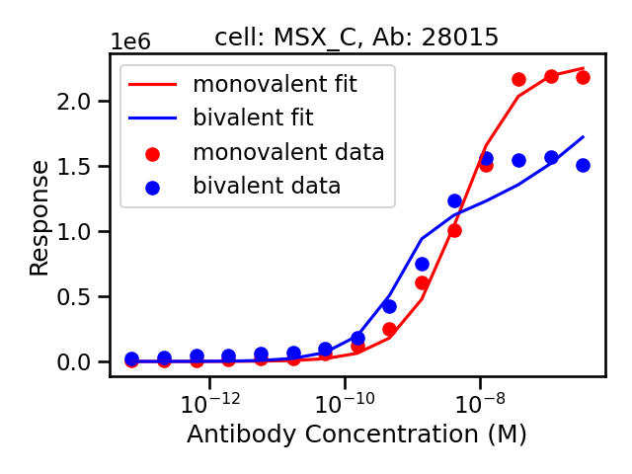

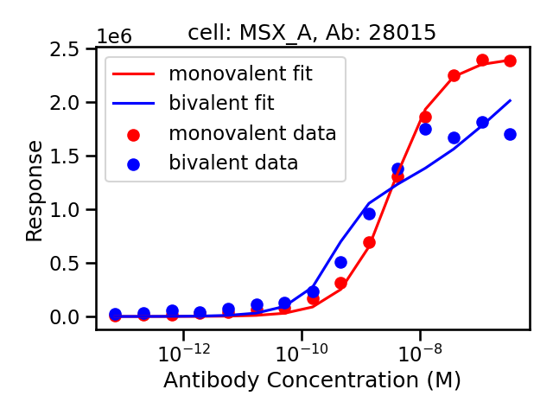

Slide 11
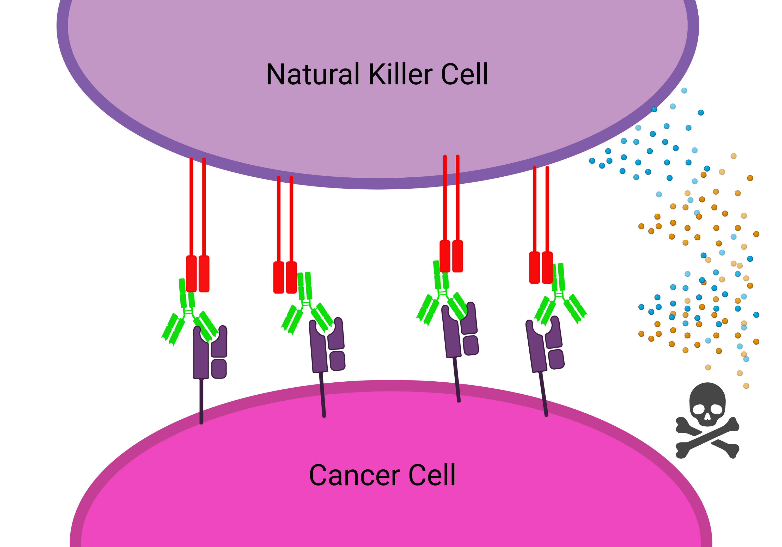
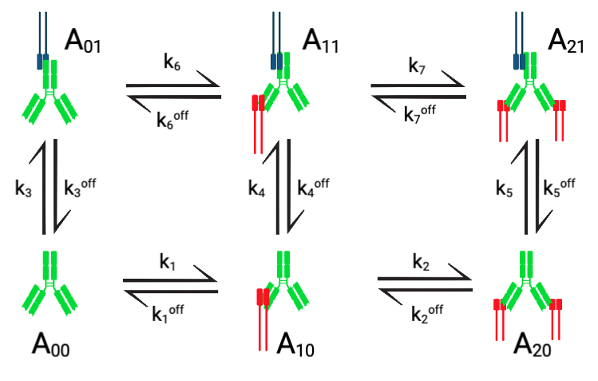
Synapse Model

Slide 12
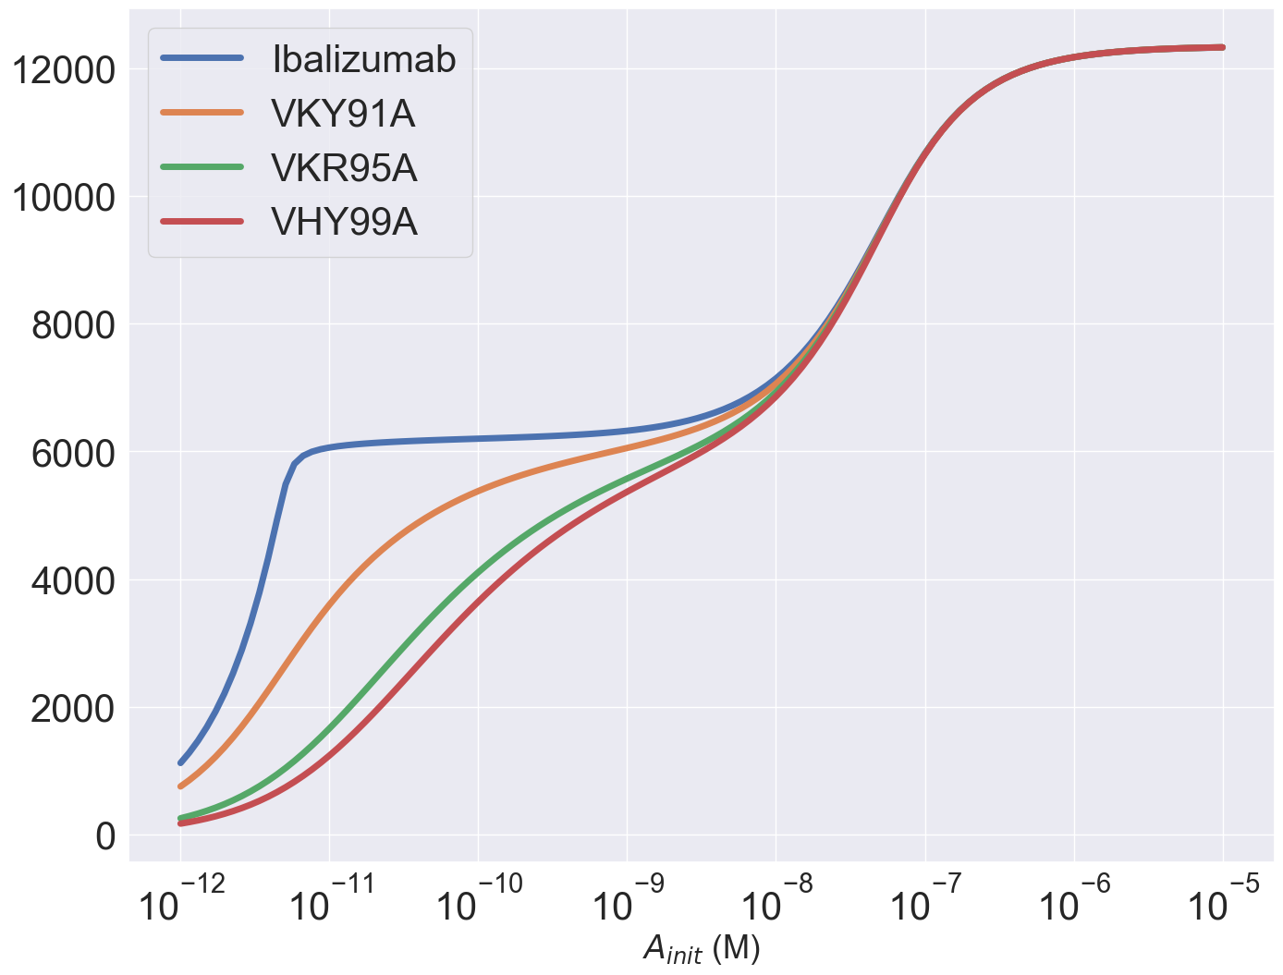
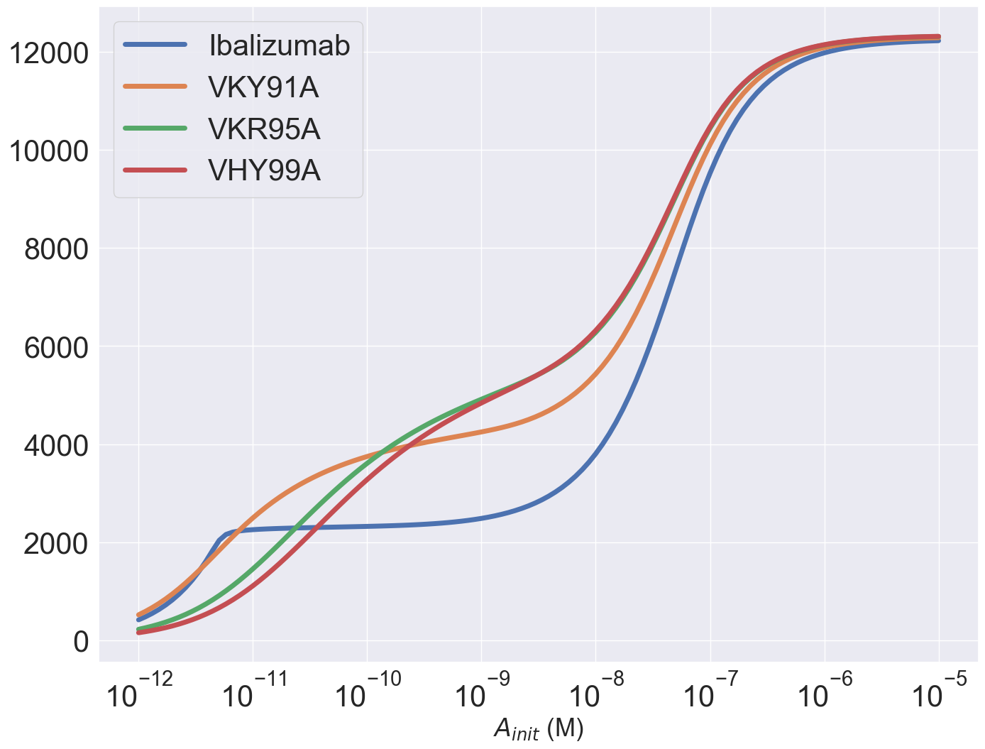
Decreasing Reaction Rate for A20 binding A21 Reproduces Mazor Behavior
K5/100000
Fc_tot = 10^5

Slide 13
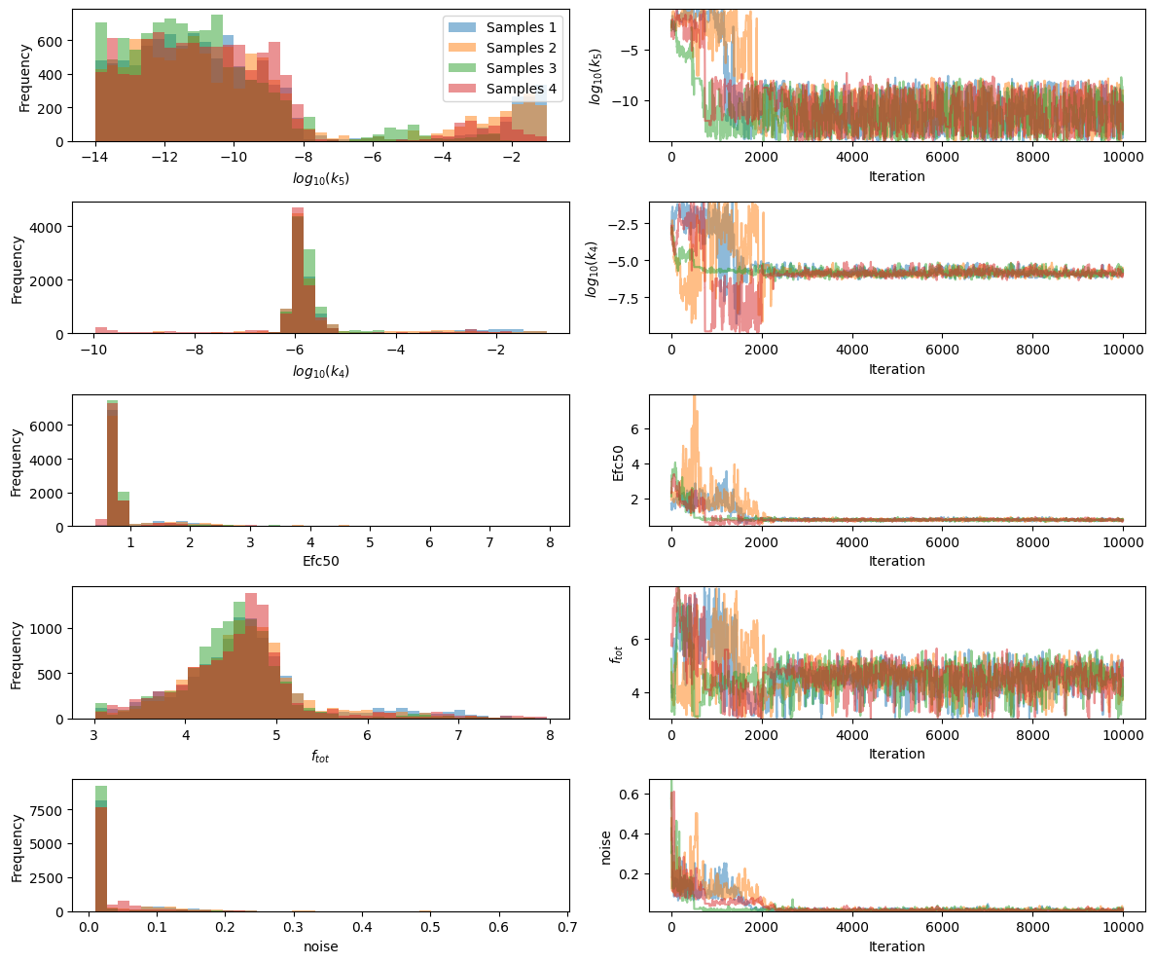
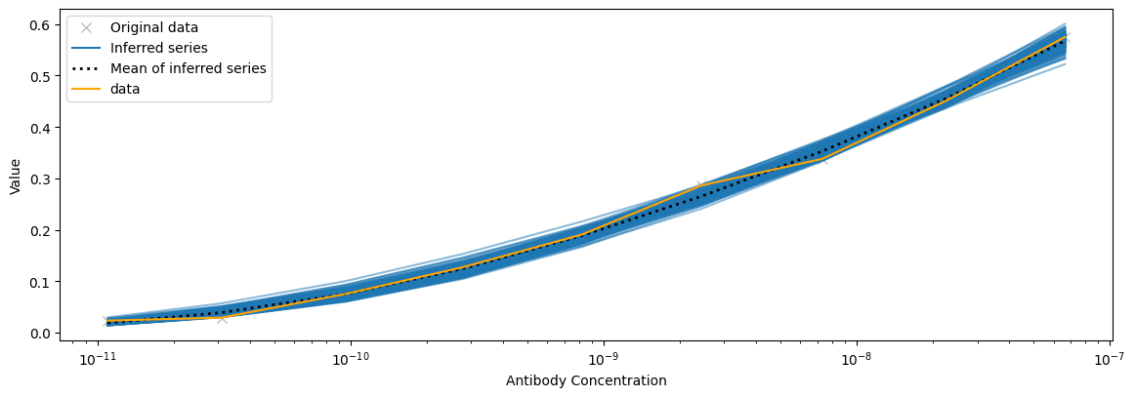
Work in Progress: VS93A+VHP97A Fitting Results (24 nM)

Slide 14
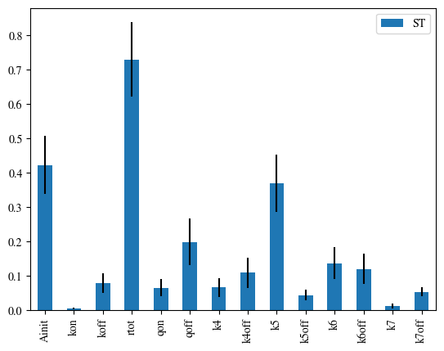
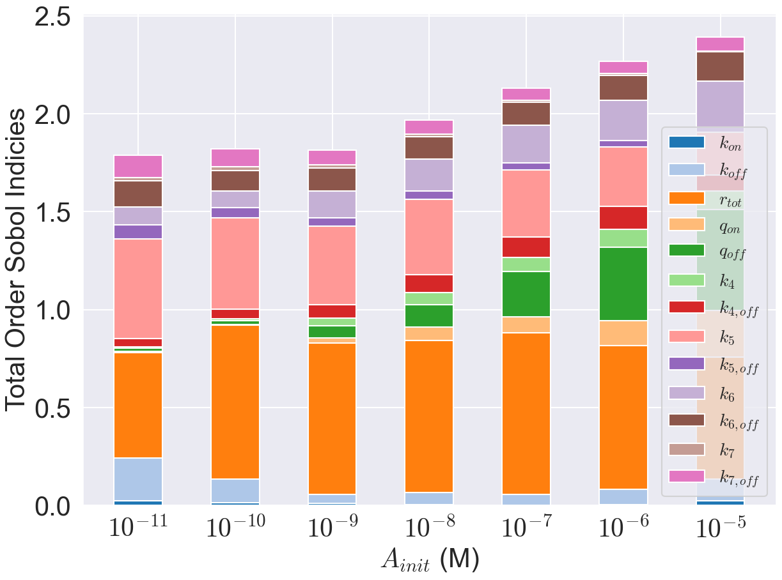
Sensitivity Analysis to Constrain Parameters

Slide 15
Next steps
Fit simultaneously across multiple mazor datasets and antibodies to confirm steric penalty.
Implications on crosslinks for other scenarios (e.g endogenous competition, prozone and fc engineering)
Best function/dataset to link binding to response
Implement into other modelling scenarios/frameworks
Use James’s data

